Slide 1

EOS
a business-oriented platform for decentralized applications
Presented by

Slide 2
Disclaimer
We are NOT in any way associated with block.one, the company developing EOS code. We are just part of the emerging EOS community.
We have no interest in you buying EOS tokens, and this certainly should not be treated as financial advice.
Our goal is to encourage you to take interest in the concept and possibly consider building businesses on top of EOS.

Slide 3
BLOCKCHAIN Evolution
System for simple payments (Bitcoin)
System for smart-contracts (Ethereum)
System for decentralized apps (EOS)

Slide 4
HOW DOES EOS WORK?
Applications
Operating System
Computer

Slide 5
HOW DOES EOS WORK?
Applications
Operating System
EOS
Computer

Slide 6
EOS is the blockchain for building commercial scale decentralized applications that are indistinguishable from centralized alternatives.
Daniel Larimer, CTO of block.one

Slide 7
What does A decentralized app require?
High performance
Free for the users
Easily accessible
No fancy cryptographic stuff
Bug recovery
Upgradability
Account recovery
Privacy protection
Access to other blockchains

Slide 8


EOS VS. decentralized apps requirements
Ethereum |  | EOS
 | High performace
 | Free for the users
 | Easily accessible
? | No fancy cryptographic stuff
 | Account recovery
 | Privacy protection | ?
? | Access to other blockchains
? | Upgradability
 | Bug recovery

Slide 9
What are eos main features?
Infrastructure for apps
Upgradeable apps
Asynchronous communication
No transaction fees
Processing power
Built-in governance

Slide 10
Processing power
Source: eos.io

Slide 11
TWO Different WAYs OF Building A Smart-contract platform
From abtract to concrete
From concrete to abstract

Slide 12
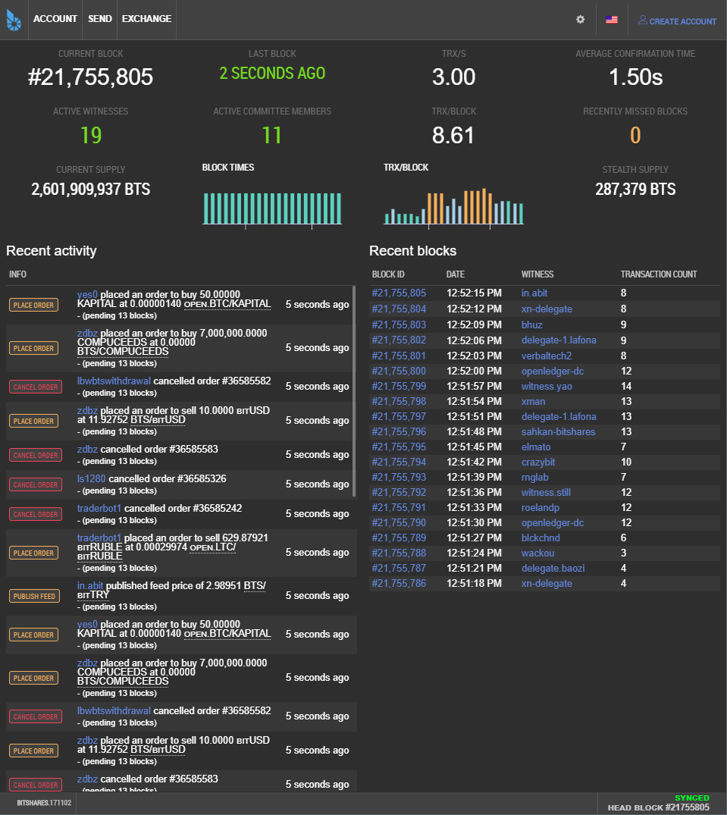
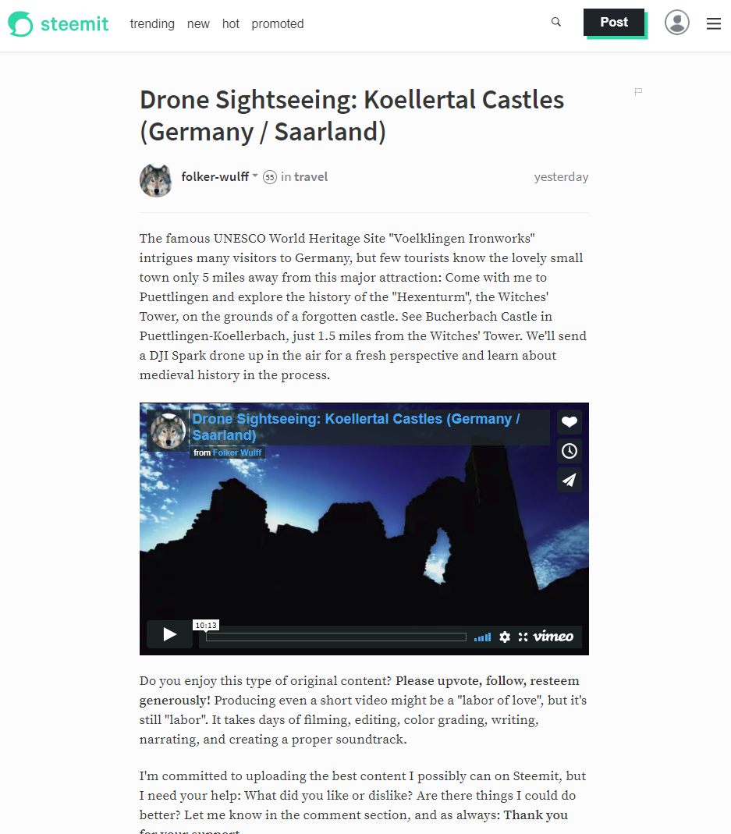
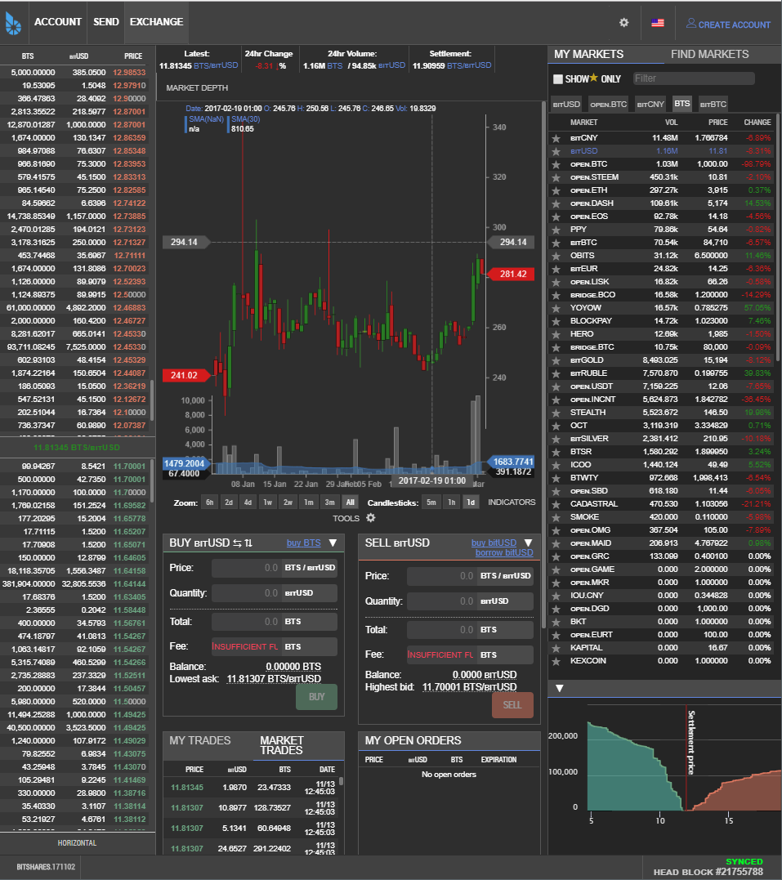
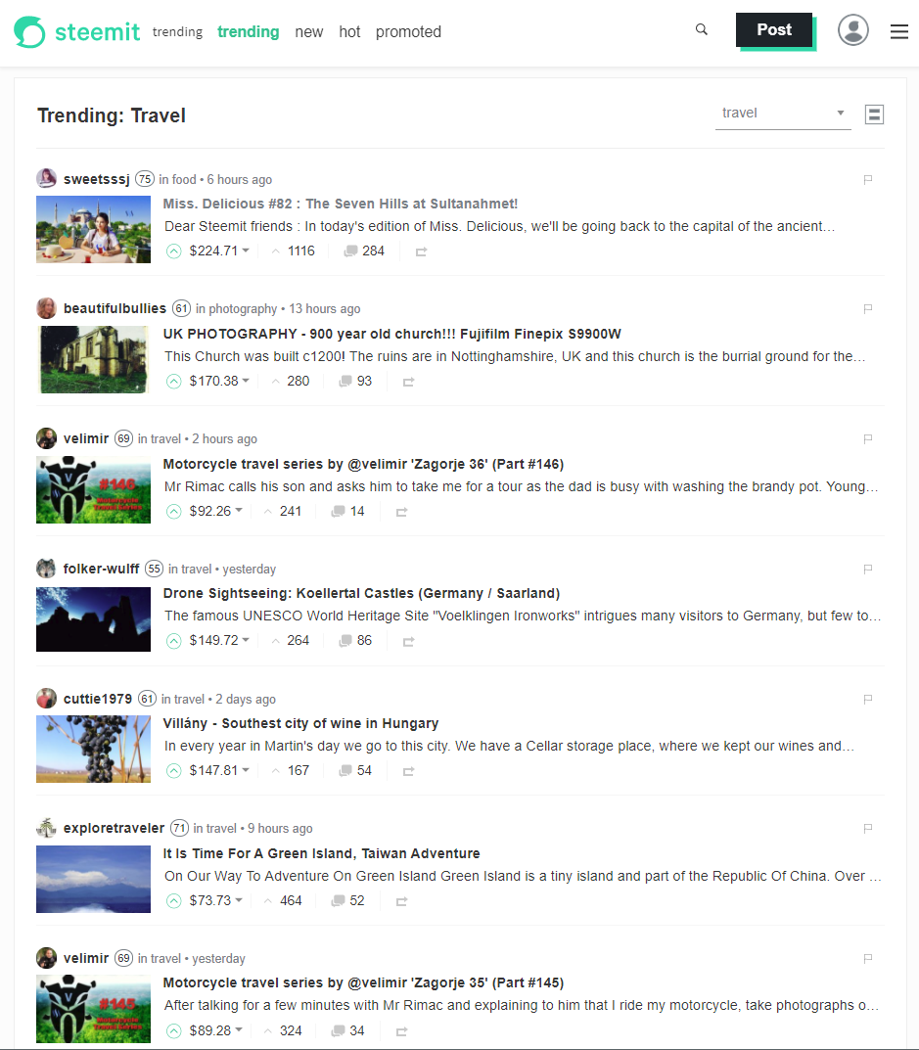
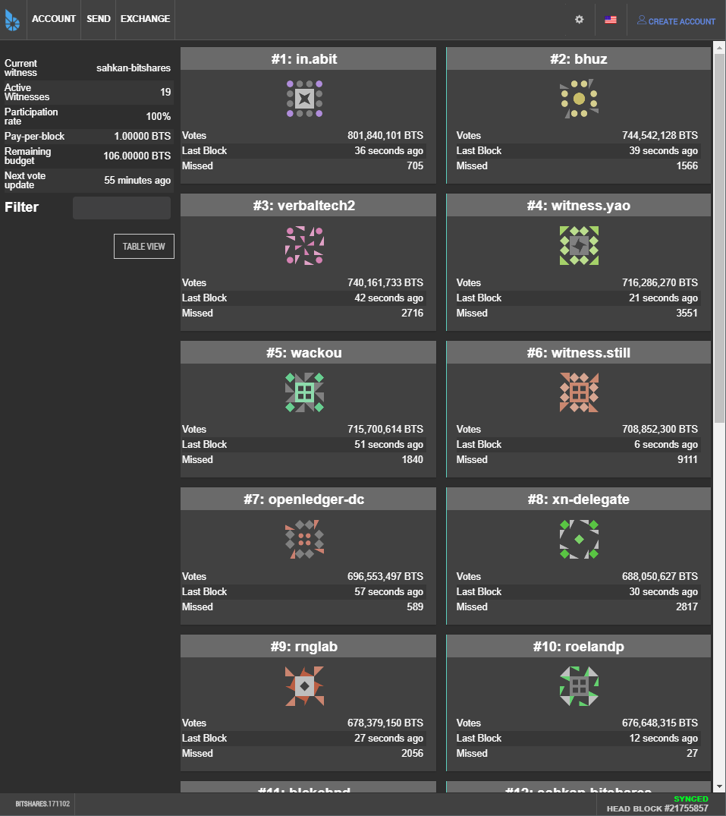
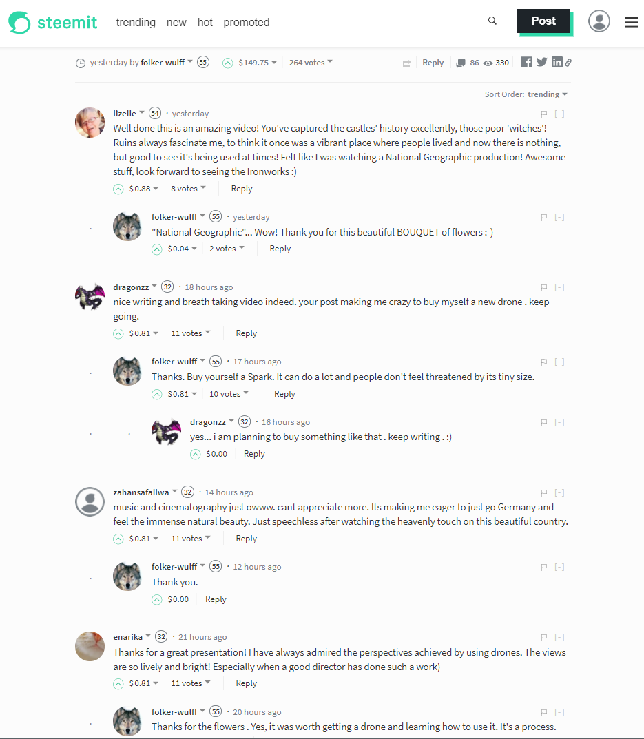
Source: bitshares.org & steemit.com

Slide 13
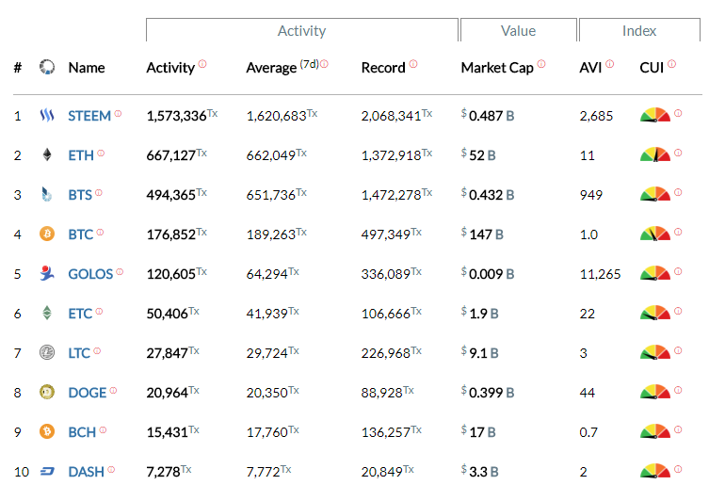
most active blockchains
Source: blocktivity.info

Slide 14
summary
Revolution or evolution?
Extremely business oriented
Pragmatic approach: people are integral part of the process

Slide 15
About Tokenika - OUR ROLE IN EOS ECOSYSTEM
Applications
Development Tools
EOS
block.one

Slide 16
Thank you
EOS - official website
www.eos.io
Any questions?
Presented by
www.tokenika.io contact@tokenika.io
facebook.com/groups/Tokenika facebook.com/groups/EOSPolska

